Slide 1
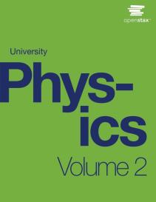

University Physics
Chapter 13 ELECTROMAGNETIC INDUCTION
PowerPoint Image Slideshow

Slide 2

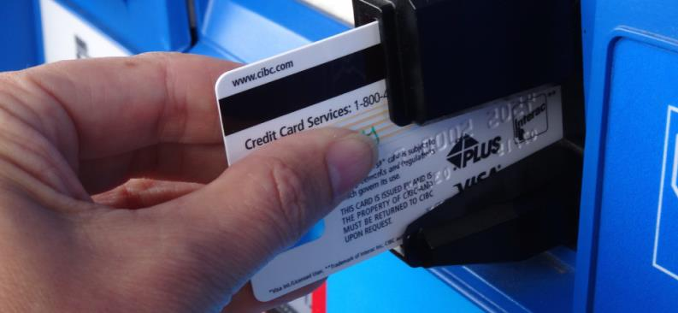
Figure 13.1
The black strip found on the back of credit cards and driver’s licenses is a very thin layer of magnetic material with information stored on it. Reading and writing the information on the credit card is done with a swiping motion. The physical reason why this is necessary is called electromagnetic induction and is discussed in this chapter.

Slide 3
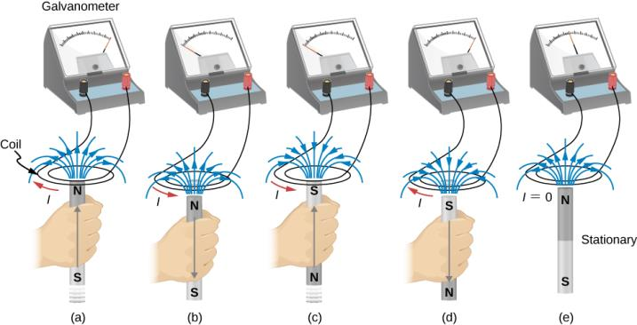
Figure 13.2
Movement of a magnet relative to a coil produces emfs as shown (a–d). The same emfs are produced if the coil is moved relative to the magnet. This short-lived emf is only present during the motion. The greater the speed, the greater the magnitude of the emf, and the emf is zero when there is no motion, as shown in (e).

Slide 4
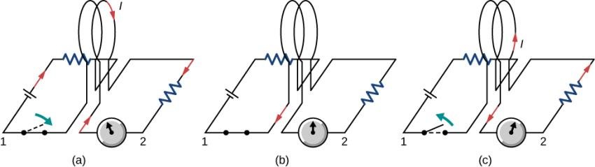
Figure 13.3
Closing the switch of circuit 1 produces a short-lived current surge in circuit 2.
If the switch remains closed, no current is observed in circuit 2.
Opening the switch again produces a short-lived current in circuit 2 but in the opposite direction from before.

Slide 5
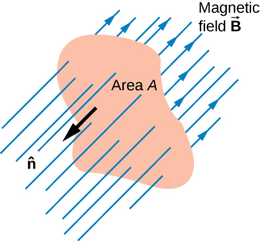
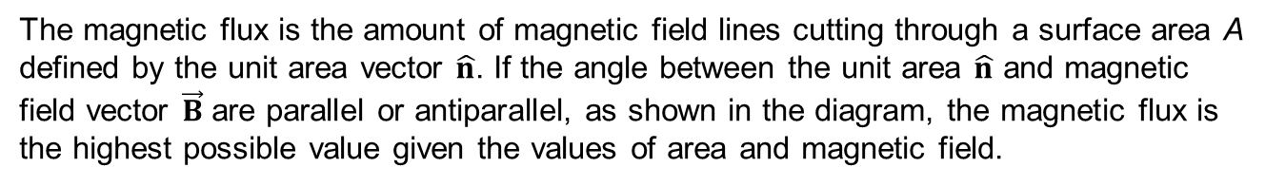
Figure 13.4
The magnetic flux is the amount of magnetic field lines cutting through a surface area A defined by the unit area vector $\hat{n}$. If the angle between the unit area $\hat{n}$ and magnetic field vector $\vec{B}$ are parallel or antiparallel, as shown in the diagram, the magnetic flux is the highest possible value given the values of area and magnetic field.

Slide 6
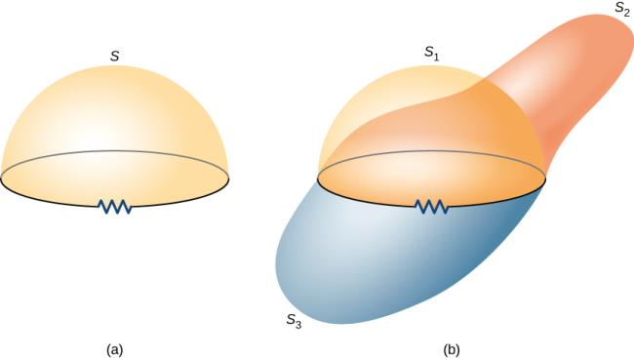
Figure 13.5
A circuit bounding an arbitrary open surface S. The planar area bounded by the circuit is not part of S.
Three arbitrary open surfaces bounded by the same circuit. The value of Φ_{m} is the same for all these surfaces.

Slide 7
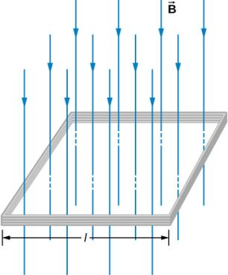
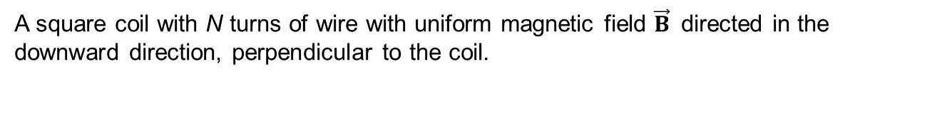
Figure 13.6
A square coil with N turns of wire with uniform magnetic field $\vec{B}$ directed in the downward direction, perpendicular to the coil.

Slide 8
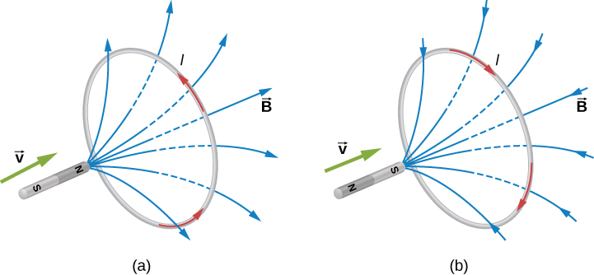
Figure 13.7
The change in magnetic flux caused by the approaching magnet induces a current in the loop.
An approaching north pole induces a counterclockwise current with respect to the bar magnet.
An approaching south pole induces a clockwise current with respect to the bar magnet.

Slide 9
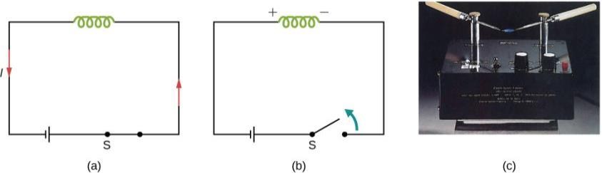
Figure 13.8
A solenoid connected to a source of emf.
Opening switch S terminates the current, which in turn induces an emf in the solenoid.
Potential difference between the ends of the sharply pointed rods is produced by inducing an emf in a coil. This potential difference is large enough to produce an arc between the sharp points.

Slide 10
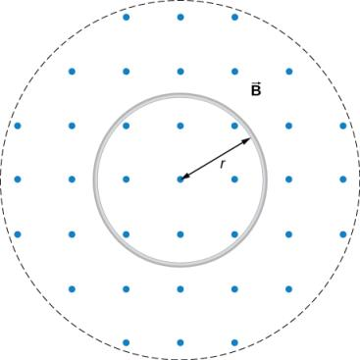
Figure 13.9
A circular coil in a decreasing magnetic field.

Slide 11
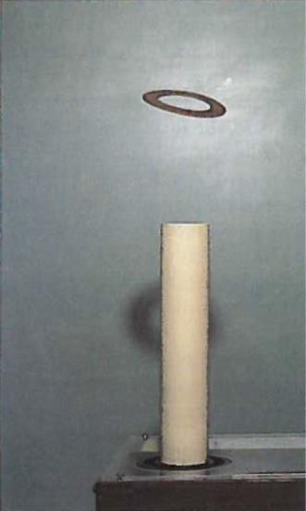
Figure 13.10
The jumping ring. When a current is turned on in the vertical solenoid, a current is induced in the metal ring. The stray field produced by the solenoid causes the ring to jump off the solenoid.

Slide 12
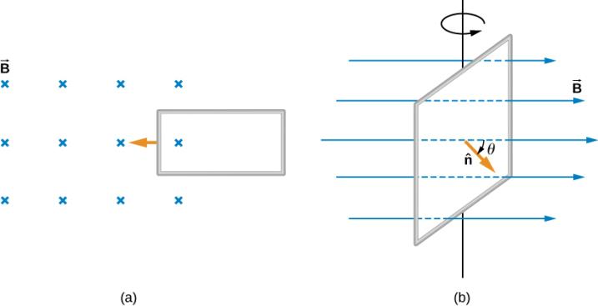
Figure 13.11
Magnetic flux changes as a loop moves into a magnetic field;
magnetic flux changes as a loop rotates in a magnetic field.

Slide 13
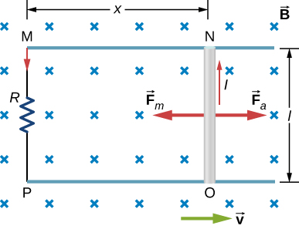
Figure 13.12
A conducting rod is pushed to the right at constant velocity. The resulting change in the magnetic flux induces a current in the circuit.

Slide 14
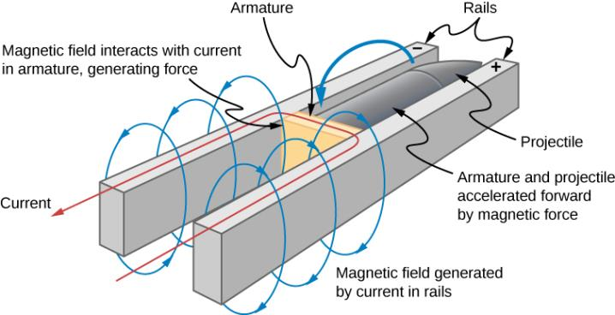
Figure 13.13
Current through two rails drives a conductive projectile forward by the magnetic force created.

Slide 15
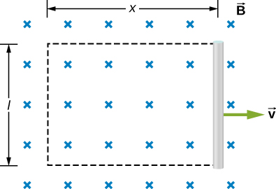
Figure 13.14
With the imaginary rectangle shown, we can use Faraday’s law to calculate the induced emf in the moving rod.

Slide 16
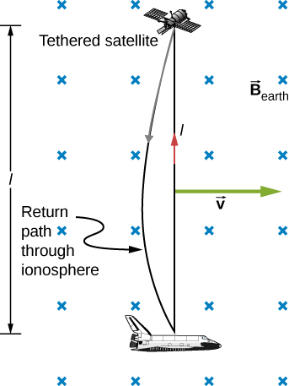
Figure 13.15
Motional emf as electrical power conversion for the space shuttle was the motivation for the tethered satellite experiment. A 5-kV emf was predicted to be induced in the 20-km tether while moving at orbital speed in Earth’s magnetic field. The circuit is completed by a return path through the stationary ionosphere.

Slide 17
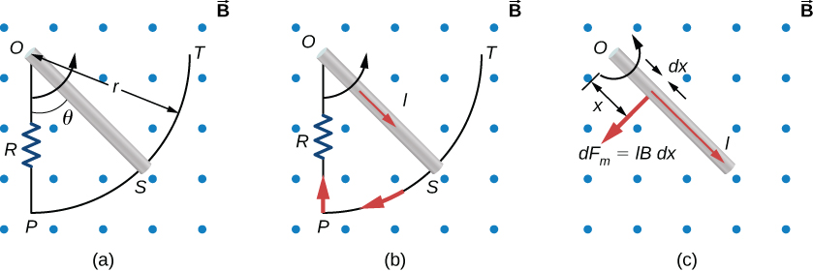
Figure 13.16
The end of a rotating metal rod slides along a circular wire in a horizontal plane.
The induced current in the rod.
The magnetic force on an infinitesimal current segment.

Slide 18
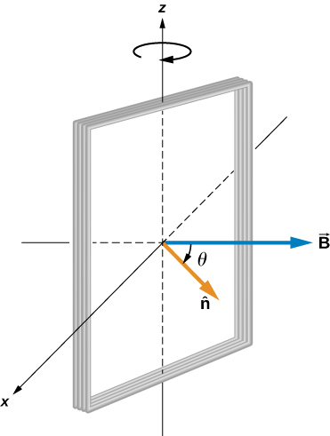
Figure 13.17
A rectangular coil rotating in a uniform magnetic field.

Slide 19
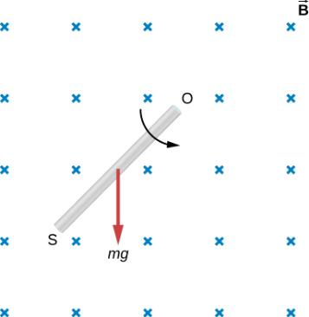
Exercise 13.4

Slide 20
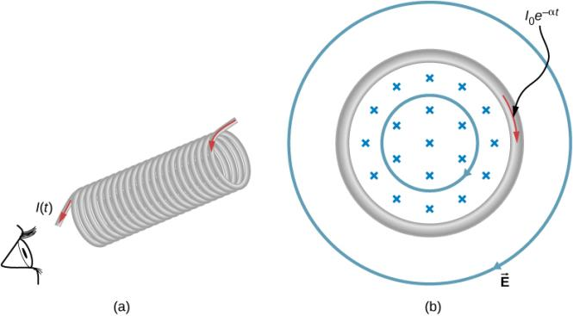
Figure 13.18
The current in a long solenoid is decreasing exponentially.
A cross-sectional view of the solenoid from its left end. The cross-section shown is near the middle of the solenoid. An electric field is induced both inside and outside the solenoid.

Slide 21
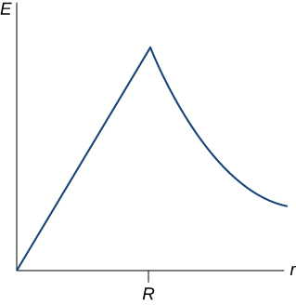
Figure 13.19
The electric field vs. distance r. When r < R, the electric field rises linearly, whereas when r > R, the electric field falls of proportional to 1/r.

Slide 22
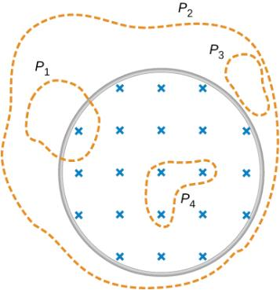
Exercise 13.8

Slide 23
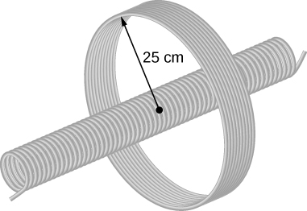
Exercise 13.9

Slide 24
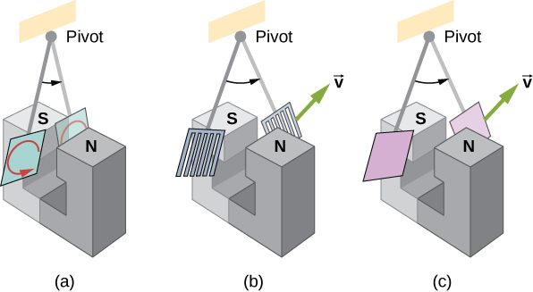
Figure 13.20
A common physics demonstration device for exploring eddy currents and magnetic damping. (a) The motion of a metal pendulum bob swinging between the poles of a magnet is quickly damped by the action of eddy currents. (b) There is little effect on the motion of a slotted metal bob, implying that eddy currents are made less effective. (c) There is also no magnetic damping on a nonconducting bob, since the eddy currents are extremely small.

Slide 25
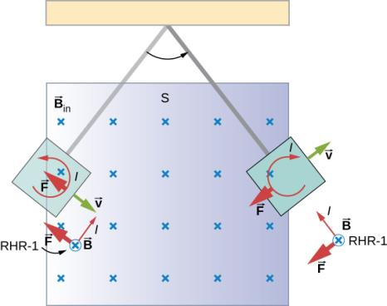
Figure 13.21
A more detailed look at the conducting plate passing between the poles of a magnet. As it enters and leaves the field, the change in flux produces an eddy current. Magnetic force on the current loop opposes the motion. There is no current and no magnetic drag when the plate is completely inside the uniform field.

Slide 26
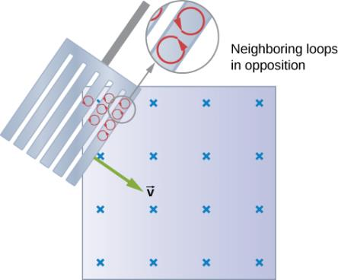
Figure 13.22
Eddy currents induced in a slotted metal plate entering a magnetic field form small loops, and the forces on them tend to cancel, thereby making magnetic drag almost zero.

Slide 27
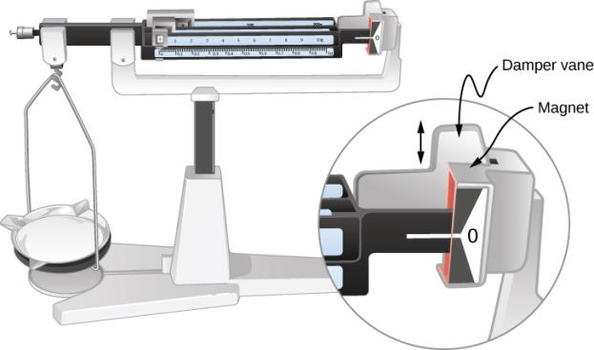
Figure 13.23
Magnetic damping of this sensitive balance slows its oscillations. Since Faraday’s law of induction gives the greatest effect for the most rapid change, damping is greatest for large oscillations and goes to zero as the motion stops.

Slide 28
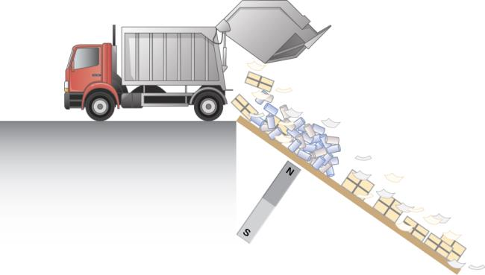
Figure 13.24
Metals can be separated from other trash by magnetic drag. Eddy currents and magnetic drag are created in the metals sent down this ramp by the powerful magnet beneath it. Nonmetals move on.

Slide 29
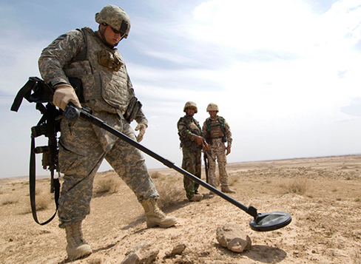
Figure 13.25
A soldier in Iraq uses a metal detector to search for explosives and weapons. (credit: U.S. Army)

Slide 30
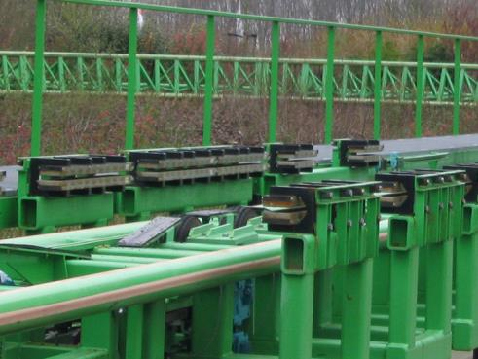
Figure 13.26
The rows of rare-earth magnets (protruding horizontally) are used for magnetic braking in roller coasters. (credit: Stefan Scheer)

Slide 31
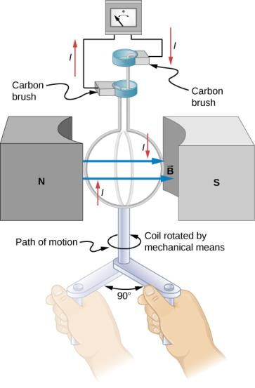
Figure 13.27
When this generator coil is rotated through one-fourth of a revolution, the magnetic flux Φ_{m} changes from its maximum to zero, inducing an emf.

Slide 32
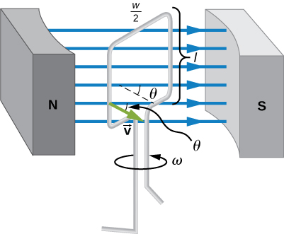
Figure 13.28
A generator with a single rectangular coil rotated at constant angular velocity in a uniform magnetic field produces an emf that varies sinusoidally in time. Note the generator is similar to a motor, except the shaft is rotated to produce a current rather than the other way around.

Slide 33
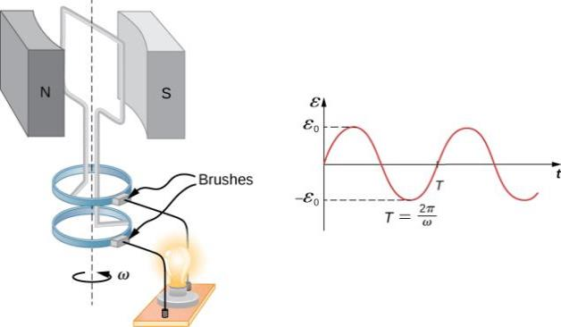
Figure 13.29
The emf of a generator is sent to a light bulb with the system of rings and brushes shown. The graph gives the emf of the generator as a function of time, where 𝜀₀ is the peak emf. The period is T = 1/f = 2π/𝜔, where f is the frequency.

Slide 34
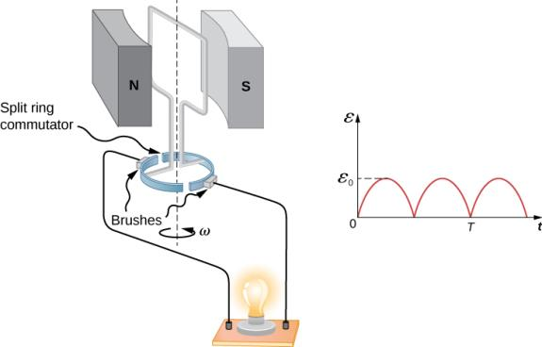
Figure 13.30
Split rings, called commutators, produce a pulsed dc emf output in this configuration.

Slide 35
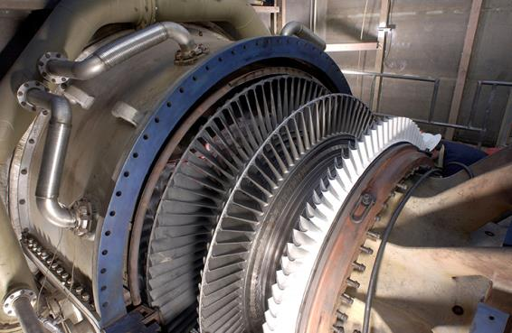
Figure 13.31
Steam turbine/generator. The steam produced by burning coal impacts the turbine blades, turning the shaft, which is connected to the generator.

Slide 36
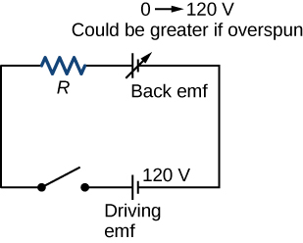
Figure 13.32
The coil of a dc motor is represented as a resistor in this schematic. The back emf is represented as a variable emf that opposes the emf driving the motor. Back emf is zero when the motor is not turning and increases proportionally to the motor’s angular velocity.

Slide 37
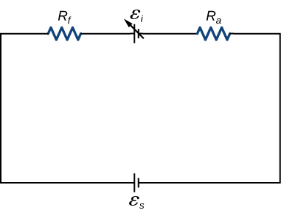
Figure 13.33
Circuit representation of a series-wound direct current motor.

Slide 38
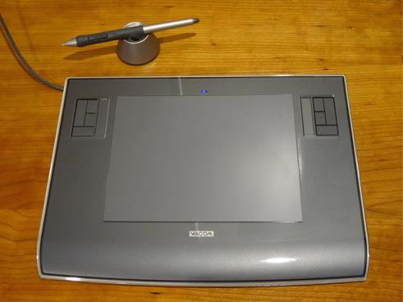
Figure 13.34
A tablet with a specially designed pen to write with is another application of magnetic induction.

Slide 39
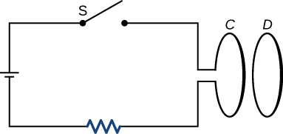
Exercise 6

Slide 40

Exercise 11

Slide 41
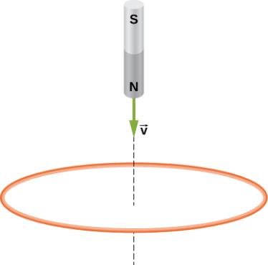
Exercise 12

Slide 42
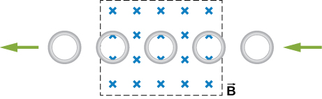
Exercise 13

Slide 43
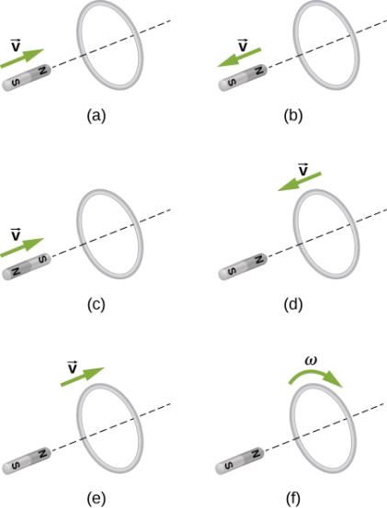
Exercise 15

Slide 44
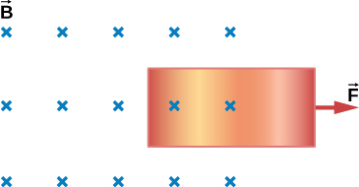
Exercise 20

Slide 45
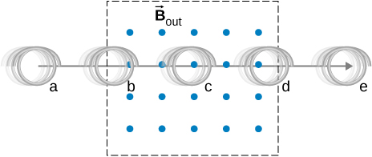
Exercise 23

Slide 46
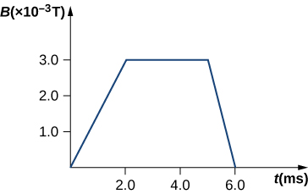
Exercise 27

Slide 47
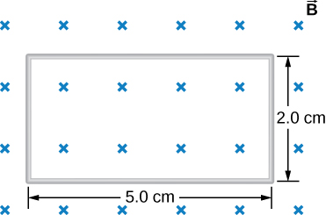
Exercise 28

Slide 48
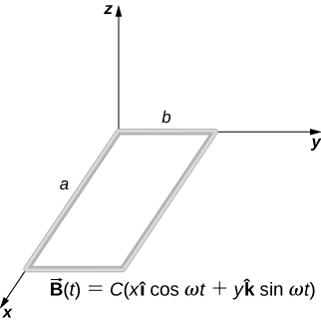
Exercise 31

Slide 49
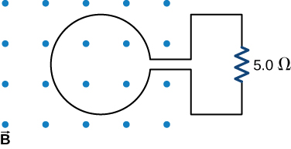
Exercise 35

Slide 50

Exercise 36

Slide 51

Exercise 38

Slide 52

Exercise 41

Slide 53

Exercise 42

Slide 54

Exercise 43

Slide 55

Exercise 44

Slide 56

Exercise 45

Slide 57

Exercise 46

Slide 58

Exercise 51

Slide 59

Exercise 52

Slide 60

Exercise 63

Slide 61

Exercise 69

Slide 62

Exercise 70

Slide 63

Exercise 72

Slide 64

Exercise 78

Slide 65

Exercise 79

Slide 66

Exercise 80

Slide 67

Exercise 81

Slide 68

Exercise 82

Slide 69

Exercise 83

Slide 70

Exercise 84

Slide 71

Exercise 86

Slide 72

Exercise 90

Slide 73

Exercise 91

Slide 74

This OpenStax ancillary resource is © Rice University under a CC-BY 4.0 International license; it may be reproduced or modified but must be attributed to OpenStax, Rice University and any changes must be noted.

